Slide 1

Project 1
Group 2
Zac Williams
Cole O’Neill
Joe Fisher
Justin Clawson
Selena Passeno

Slide 2

Agenda
Project Topic – Main Questions
Data Sources, Exploration & Clean Up
Analysis Process
Conclusions – Numerical Summary & Visuals
Implications of Findings

Slide 3

Project Topic
Main Questions:
Is there a correlation between inflation and unemployment?
Is there a correlation between inflation and interest rates?
Summary of inflation/unemployment impacts on a regional/state basis?
Five-year analysis to determine trends prior, during and post Covid.

Slide 4




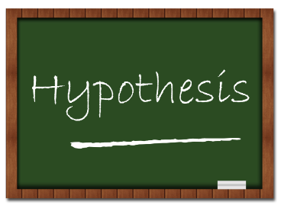

Data Exploration & Clean Up

Slide 5
Question One - Overview
Correlation between inflation and unemployment?
Data Sources
Clean Up Process
Jupyter Notebook
Data Analysis
Results

Slide 6
Question One - Process
Jupyter notebook showing code used to clean data

Slide 7
Question One – Graph 1
Notes:
Add Visuals

Slide 8
Question One – Graph 2
Notes:
Add Visuals

Slide 9
Question Two - Overview
Correlation between inflation and interest rates?
Data Sources
Clean Up Process
Jupyter Notebook
Data Analysis
Results

Slide 10
Question Two - Process
Jupyter notebook showing code used to clean data

Slide 11
Question Two – Graph 1

Slide 12
Question Two – Graph 2

Slide 13
Question Three - Overview
Correlation between inflation and interest rates?
Data Sources
Clean Up Process
Jupyter Notebook
Data Analysis
Results

Slide 14
Question Three - Process
Jupyter notebook showing code used to clean data

Slide 15
Question Three – Graph 1

Slide 16
Question Three – Graph 2

Slide 17



Summary
Close out presentation with the implication of our findings and what they mean to us.

Slide 18
Content – Extra slide to use
Subtitle
Subtitle
Add text, images, art, and videos.
Add transitions, animations, and motion.
Save to OneDrive, to get to your presentations from your computer, tablet, or phone.
Add text, images, art, and videos.
Add transitions, animations, and motion.
Save to OneDrive, to get to your presentations from your computer, tablet, or phone.

Slide 19
Content 2
Subtitle
Subtitle
Subtitle
Add text, images, art, and videos.
Add transitions, animations, and motion.
Save to OneDrive, to get to your presentations from your computer, tablet, or phone.
Add text, images, art, and videos.
Add transitions, animations, and motion.
Save to OneDrive, to get to your presentations from your computer, tablet, or phone.
Add text, images, art, and videos.
Add transitions, animations, and motion.
Save to OneDrive, to get to your presentations from your computer, tablet, or phone.

Slide 20


THANK YOU

Slide 21
Table
 | Category 1 | Category 2 | Category 3 | Category 4
Item 1 | 4.5 | 2.3 | 1.7 | 5
Item 2 | 3.2 | 5.1 | 4.4 | 3
Item 3 | 2.1 | 1.7 | 2.5 | 2.8
Item 4 | 4.5 | 2.2 | 1.7 | 7

